Slide 1
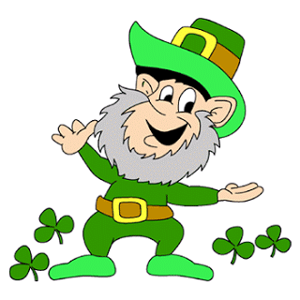
South Lewis Central School District
March Faculty Meeting

Slide 2
Goals:
Promote a Growth Mindset to EVERYONE – Believing We Can All Get Better is the Biggest and Most Important First Step
Instructional Priorities for the Year:
Post and Know your Major Goal or Essential Knowledge you want Students to Master Each Day
Check for Understanding at the End of Lessons to Make Sure Students Have It
Ways we Can Incorporate Technology to Enhance Learning for Students

Slide 3
Video
Video
Is this appropriate for you to show to your students?
Could you ask students to think about if they have a caring adult in their life that they’ve connected with and write down on a paper “yes” or “no.” If they have “no” are they willing to let you be that person for them?
How do we find those kids who lack that caring adult so they don’t fall through cracks?

Slide 4
Do We Agree…
Do we have a lot of students from poverty in our district?

Slide 5
Yes!

Slide 6
Do We Agree…
Do we have a lot of students in our district who come from dysfunctional, stressful home lives?
Some people refer to this as these children have experienced trauma.

Slide 7
What Do We Do?
From everything we are learning, one of the most important things that we need to do is to educate all of our staff AND all of our students about what happens to the brain when a person is stressed, nervous, anxious, etc.
Then, we need to explicitly talk about things to do to help that stressed, nervous, and anxious person to become healthier and calmer.
We can not keep this quiet. It needs to be openly discussed with our students all the time, so they don’t feel lonely, uncertain, afraid, and even more upset.

Slide 8
Lesson Designed by Jenny Morrill, and She Teaches Elementary Students…
Jenny designed this activity because of research cited on NPR that children with inappropriate behaviors often don't believe they can change and, therefore, don't try to change. According to the research cited on this NPR feature, a fifteen minute lesson showing students that their brain can grow and change has had a significant impact on student attitudes.

Slide 9
STRESS
What do you do?
REFER TO THE SCRIPT TO USE ALONG WITH THE SLIDES

Slide 10
Writing Journal
What kind of things stress you out? How do you react when you’re stressed? What do you do to manage (take care of) your stress?

Slide 11
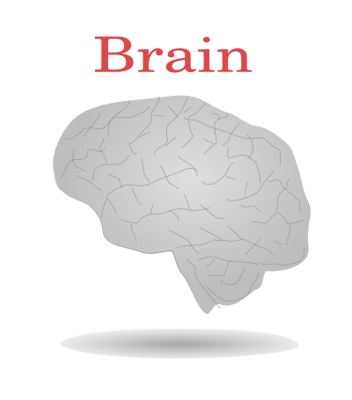
Cerebral Cortex-
Thinking, impulse control, problem solving
Limbic brain-
Emotional Part
Amygdala
Hindbrain-
Basic functions
Instincts

Slide 12
Can block thinking brain
Stressed Amygdala
May feel like wanting to explode, cry and shut down
Natural response that we can change

Slide 13
What can we do???
Overrides our amygdala…
Calms and shuts it down...
Amygdala

Slide 14
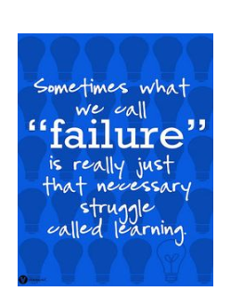
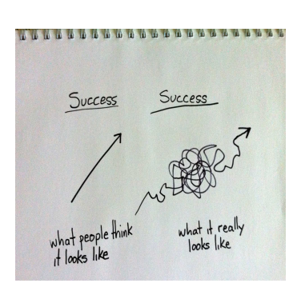
Why does this matter?

Slide 15
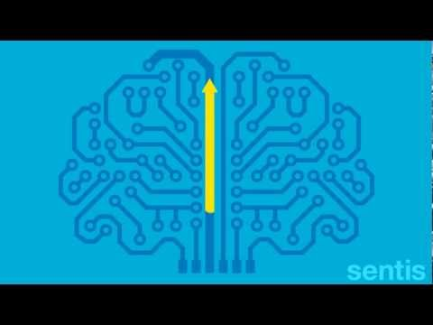
Neuroplasticity- exercise for your beautiful brain
CLICK ON THE IMAGE TO WATCH A GREAT VIDEO

Slide 16
Why does this matter?

Slide 17
Goals:
Promote a Growth Mindset to EVERYONE – Believing We Can All Get Better is the Biggest and Most Important First Step
This lesson is an example of a Growth Mindset – with practice and effort we can change how our brain works.
This lesson is also teaching students skills that are critical and typically not directly talked about and taught in classrooms.
Please share this lesson with your students. IF NOT YOU, THEN WHO? WE HAVE TO FIGURE OUT WHERE TO FIT THIS IN.
Instructional Priorities for the Year:
Post and Know your Major Goal or Essential Knowledge you want Students to Master Each Day
Check for Understanding at the End of Lessons to Make Sure Students Have It
Ways we Can Incorporate Technology to Enhance Learning for Students

